Slide 1

Shell Scheme Package

Slide 2
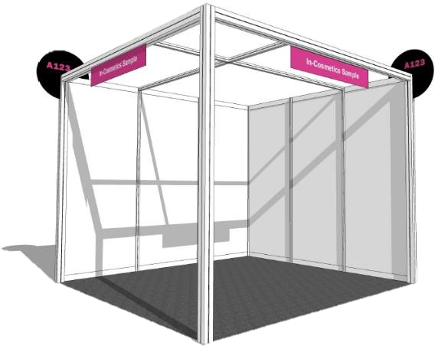
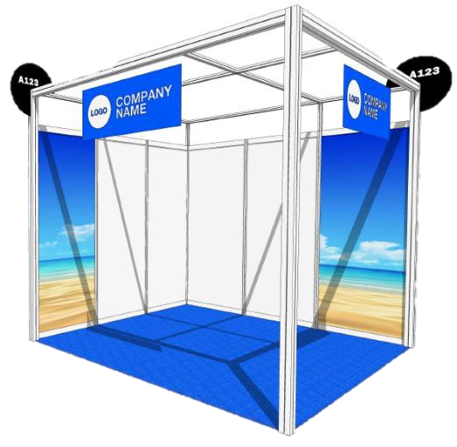
Shell Scheme Packages 2024
Standard Shell Scheme
Premium Shell Scheme
Items | Shell Scheme | Premium Shell Scheme
Stand Height | 2.48m | 2.89m [+40cm higher]
Logo | No | Yes
Fascia Height | 300mm | 600mm
Fascia Colour | Pink (no other choice) | Choice of 13 colours (see page 2)
Carpet Colour | Grey (No other choice) | Choice of 40 colours (see page 2)
Graphic Panel | No | 2 (With the possibility to order extra panels)
Cost / sqm | €130 per sqm | €210 per sqm

Slide 3
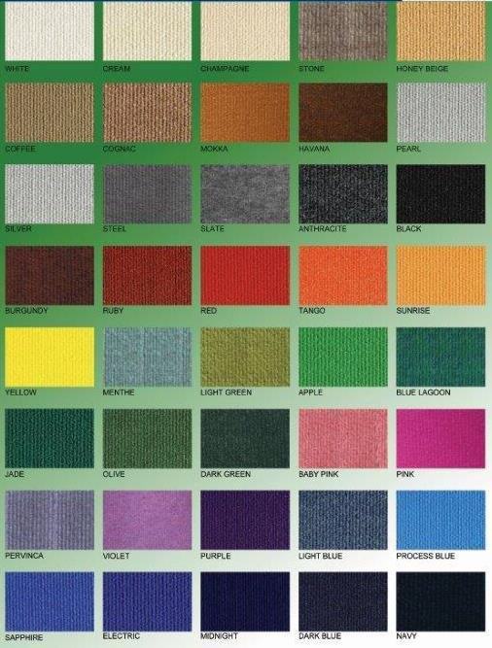
Shell Scheme Packages 2024
Carpet Colour Options

Slide 4
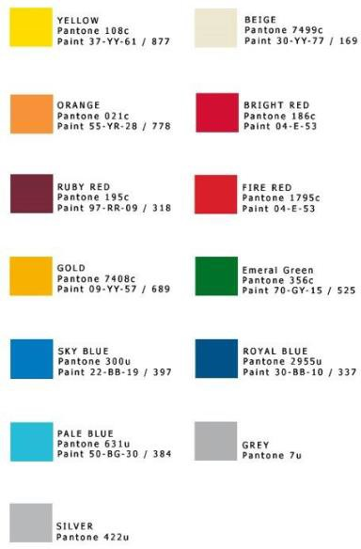
Shell Scheme Packages 2024
Fascia Colour Options

